Slide 1


The Blind Spot in Image Lifecycle: EOS Components
Today's CI/CD pipelines often lack visibility into container image lifecycles. Containers are built and shipped with end-of-support (EOS) binaries and outdated base images.
These unsupported components introduce serious security risks. They reduce compliance and increase technical debt across environments.
by CodeZero Zero

Slide 2
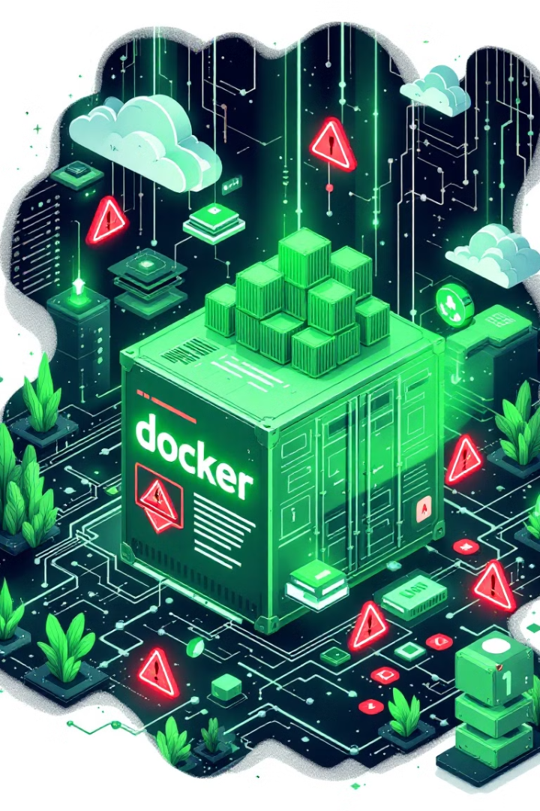



When Unsupported Images Slip Through: Why It Matters
Unpatched Vulnerabilities
Reactive Approach
Manual audits are slow and inconsistent. Issues are found too late.
EOS components may contain known vulnerabilities that will never be fixed.
Operational Impact
Support teams face recurring issues. Production suffers from preventable errors.

Slide 3
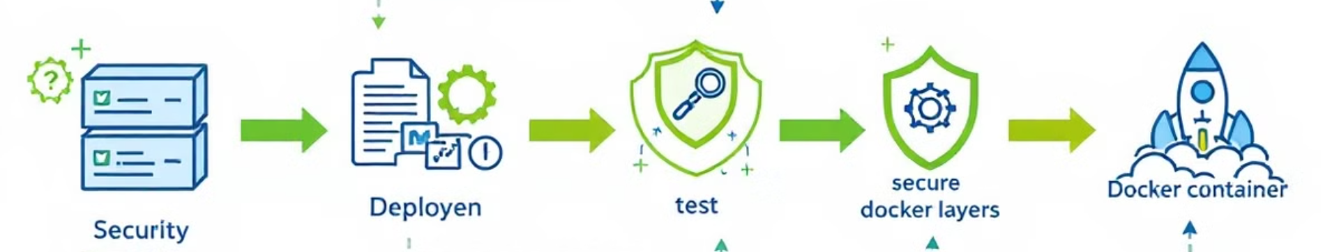




Lifecycle Guardrails: Jenkins-Driven EOS Detection
Parse Image Layers
Jenkins extracts data from all Docker image components during build.
Check EOS Databases
Component versions are verified against EOS and CVE databases.
Enforce Standards
Builds with vulnerable components older than 12 months are terminated.
Recommend Fixes
Secure alternatives are suggested via recommendation logic.

Slide 4





Real-World Scenario: Java JDK 8 on UBI
Development Stage
Team uses UBI-based image with OpenJDK 8 for Java applications.
Detection Stage
Scanner finds OpenJDK 8, approaching EOS in November 2026.
Enforcement Stage
Build terminates if vulnerabilities are found with the outdated JDK.
Feedback Loop
System suggests upgrading to OpenJDK 11+ for continued support.

Slide 5
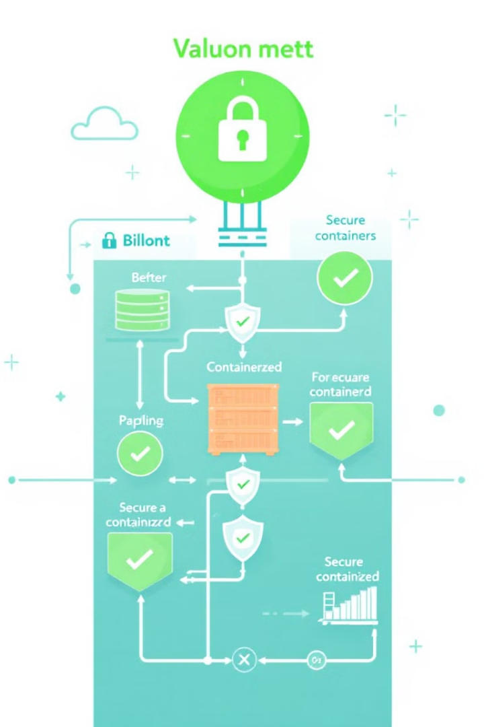
Results: Secure Image Lifecycle. Predictable Pipelines.
100%
Supported Images
Only secure images move forward in the pipeline.
0
Security Debt
Prevents security issues from entering production.
60%
Reduced Tickets
Lower platform team load from preventable issues.
90%
Automated Hygiene
Reinforces lifecycle standards with minimal manual effort.

